Slide 1
Leadership
Cdr Vijay Pratap Singh
Adjunct Professor, E&TC, TCET
.
Notes:
1

Slide 2
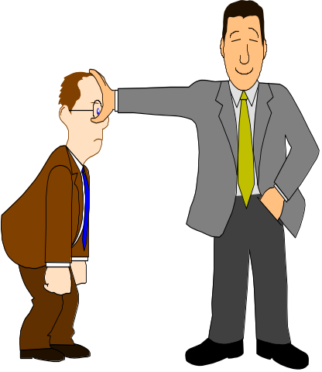
Leadership
The ability to positively influence people and systems to have a meaningful impact and achieve results

Slide 3
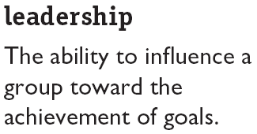
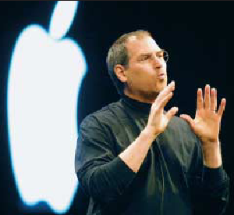
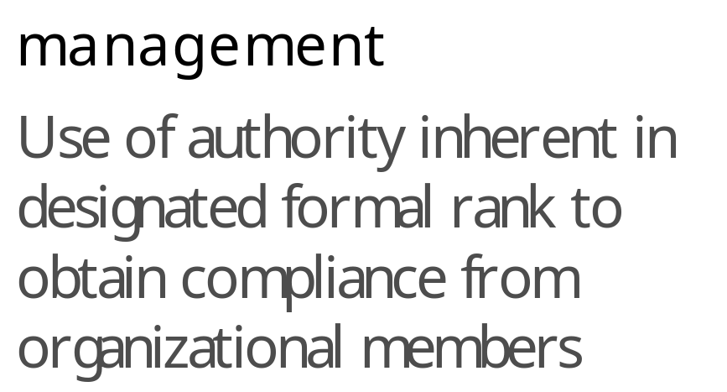
What is Leadership?

Slide 4
Concept of Leadership
Leadership is a process by which a person influences others to accomplish an objective and directs the organization in a way that makes it more cohesive and coherent. Leaders carry out this process by applying their leadership attributes, such as beliefs, values, ethics, character, knowledge, and skills.

Slide 5
Leadership Skills
Vision
Courage
Integrity
Humility.in behaviour ...
Strategic Planning. ...
Focus on Goal ...
Cooperation. With its team members...
Great Leaders Keep A Positive Attitude.
Self-Awareness
Communication Skills ...
Influence. ...
Learning Ability.
Leading from personal examples

Slide 6
Traditional leadership theories
The trait approach--Involves discerning how to be a leader by examining the characteristics and methods of recognized leaders.
b) The behavioral approach--Attempts to determine the types of leadership behaviors that lead to successful task performance and employee satisfaction.
c) The contingency approach--Holds that there is no universal approach to leadership. Rather, effective leadership behavior depends on situational factors (i.e. who is leading, who is led, and what is the situation) that may change over time.
d) The role approach--Suggests that leaders perform certain roles depending on the situation.

Slide 7
Characteristics of Successful Leaders
Trait or Characteristic
Drive
Honesty and integrity
Leadership motivation
Self-confidence
Cognitive ability
Knowledge of the business
Creativity
Flexibility
Description
Desire for achievement; ambition; high energy;
tenacity; initiative
Trustworthy; reliable; open
Desire to exercise influence over others to reach shared goals
Trust in own abilities
Intelligence; ability to integrate and interpret large amounts of information
Knowledge of industry, relevant technical matters
Originality
Ability to adapt to needs of followers and
requirements of situation
-1
Notes:
3

Slide 8

Truly Humble - Leads to Serve
Non-Judgmentally Observant
Faces and Solves Problems
Ruthlessly Improves
Is Fiscally Conservative
Invests in the Business
Communicates
Gives Clear Direction
Is an Aggressive “Revolutionizer"
Has a Sense of Humor

Slide 9
Know yourself and seek self-improvement
Make sound and timely decisions
Be technically proficient
Set the example
Train as a team
Know your people and look out for their well-being
Ensure that tasks are understood, supervised, and accomplished

Slide 10
Attributes of a effective leader
BE a professional. Examples: Be loyal to the organization, perform selfless service, take personal responsibility.
BE a professional who possess good character traits. Examples: Honesty, competence, candor, commitment, integrity, courage, straightforwardness, imagination.
KNOW yourself. Examples: strengths and weakness of your character, knowledge, and skills.
KNOW human nature. Examples: Human needs, emotions, and how people respond to stress.
KNOW your job. Examples: be proficient and be able to train others in their tasks.
DO provide direction. Examples: goal setting, problem solving, decision making, planning.
DO implement. Examples: communicating, coordinating, supervising, evaluating.
DO motivate. Examples: develop morale in the organization, train, coach, counsel.

Slide 11
Leadership Styles
Autocratic. ...
Authoritative. ...
Pacesetting. ...
Democratic. ...
Coaching. ...
Affiliative. ...
Laissez-Faire. a laissez-faire attitude is one in which you do not get involved in other people's activities or behaviour. Synonyms and related words. Not involved in something.

Slide 12
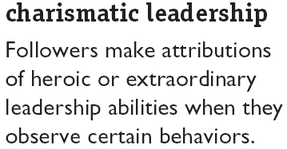
Charismatic Leadership
Key Characteristics:
Vision and articulation
Personal risk
Environmental sensitivity
Sensitivity to follower needs
Unconventional behaviour

Slide 13
Path-Goal Theory
Leader’s style
(instrumental,
supportive,
participative,
achievement-
oriented)
Contingency factors
(characteristics
of subordinates,
work environments)
Perception that
the leader is
being helpful
(e.g., eliminating
obstacles)
Motivation and
job satisfaction
are enhanced
Notes:
8

Slide 14
Situational Leadership Theory: Its Basic Dimensions
High
(unwilling
to do job)
Participating works best
(followers are able to
do the job but require
emotional support)
Selling works best
(followers are neither
willing nor able to do
the job)
Relationship Behavior
(amount of support required)
Delegating works best
(followers)are willing to
do the job, and know
how to go about it)
Telling works best
(followers are willing
to do the job, but don’t
know how to do it)
Low
(willing
to do job)
Low
(able to do job)
Task Behavior (amount of guidance required)
High
(unable to do job)
.
Notes:
9

Slide 15
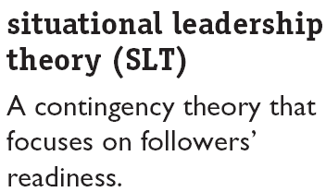
Hersey and Blanchard’s Situational Leadership Theory
Follower readiness: ability and willingness
Leader: decreasing need for support and supervision

Slide 16
The Managerial Grid
High
1,9 pattern
“Country club”
management
9
9,9 pattern
Team management-
the ideal style
8
7
6
Concern for People
5,5 pattern
Middle-of-the-road
management
5
4
3
1,1 pattern
Impoverished
management
2
9,1 pattern
Task management
1
Low
1 2 3 4 5 6 7 8 9
Low
Concern for Production
High
Fig. 8-1
Notes:
4

Slide 17
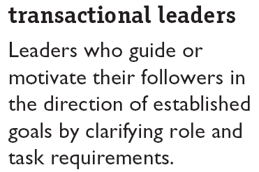
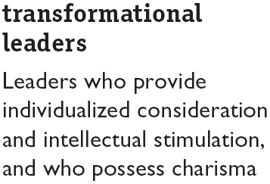
Transactional and Transformational Leadership
Contingent Reward
Management by Exception (active)
Management by Exception (passive)
Laissez-Faire
Charisma
Inspiration
Intellectual Stimulation
Individual Consideration

Slide 18
Emotional Intelligence and Leadership Effectiveness
Elements of Emotional Intelligence:
Self-awareness
Self-management
Self-motivation
Empathy
Social skills

Slide 19
Guidelines for Becoming a Transformational Leader (cont’d)
Suggestion
Build confidence by recognizing small
accomplishments toward the goal.
Celebrate successes and accomplishments.
Take dramatic action to symbolize key
organizational values.
Set an example; actions speak louder
than words.
Explanation
If a group experiences early success, it will
be motivated to continue working hard.
Formal or informal ceremonies are useful for
celebrating success, thereby building
optimism and commitment.
Visions are reinforced by things leaders do
to symbolize them. For example, one leader
demonstrated concern for quality by
destroying work that was not up to standards.
Leaders serve as role models. If they want
followers to make sacrifices, for example,
they should do so themselves.
Notes:
6

Slide 20
Guidelines for Becoming a Transformational Leader
Suggestion
Develop a vision that is both
clear and highly appealing to followers.
Articulate a strategy for bringing that
vision to life.
State your vision clearly and promote
it to others.
Show confidence and optimism about
your vision.
Express confidence in followers’
capacity to carry out the strategy.
Explanation
A clear vision will guide followers toward
achieving organizational goals and make them feel good about doing so.
Don’t present an elaborate plan; rather, state the best path toward achieving the mission.
Visions must not only be clear but made
compelling, such as by using anecdotes.
If a leader lacks confidence about success,
followers will not try very hard to achieve that
vision
Followers must believe that they are capable of implementing a leader’s vision. Leaders
should build followers’ self-confidence.
.
Notes:
5

Slide 21
Finding and Creating Effective Leaders
Selection
  Review specific requirements for the job.
  Use tests that identify personal traits associated with leadership, measure self-monitoring, and assess emotional intelligence.
  Conduct personal interviews to determine candidate’s fit with the job.
Training
  Recognize the all people are not equally trainable.
  Teach skills that are necessary for employees to become effective leaders.
  Provide behavioral training to increase the development potential of nascent charismatic employees.

Slide 22
LPC (Least Preferred Co-worker) Contingency Theory
Low LPC
leaders
are highly
effective
under low
situational
control
High LPC
leaders
are highly
effective
under
moderate
situational
control
Low LPC
leaders
are highly
effective
under
high
situational
control
High
Leader Effectiveness
(group performance)
Low LPC
(concern for
people)
High LPC
(concern for
production)
Low
Low
Moderate
High
Situational Control
.
Notes:
7

Slide 23
Q & A Session

